Slide 1
EVOLUTIONARY ALGORITHMS

Slide 2
Motivation
Randomness is magic
Randomness makes complex problems easy
Lot of applications

Slide 3
The GA class interface
Initialisation
Fitness
run
Simulation parameters
Cross over
Mutation
Notes:
Function better than class

Slide 4
run
mutate x and select the best
cossover and select the best
update λ
update x if necessary

Slide 5
The one max problem
Fitness: sum
Mutation: default
Crossover: default
0
1
2
0
…
1
1
1
n

Slide 6
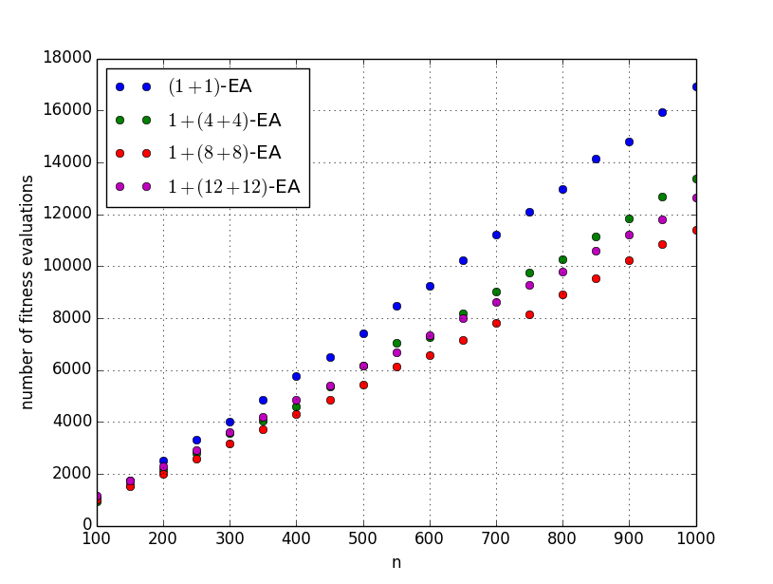

Slide 7
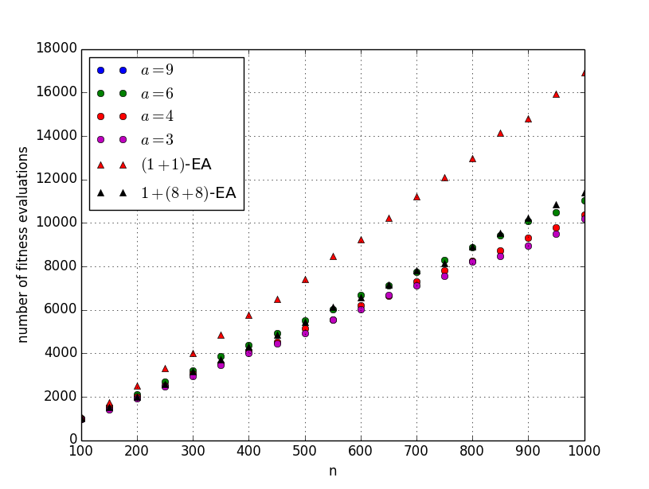
λ constant
Self adaptive λ

Slide 8
Maximum matching
Edge 2 is not
0
1
2
0
…
1
1
1
n
Fitness: |M| − m ∑ max{0,deg(v)−1}
Mutation: default
Crossover: default
Edge 0 is part of the matching

Slide 9
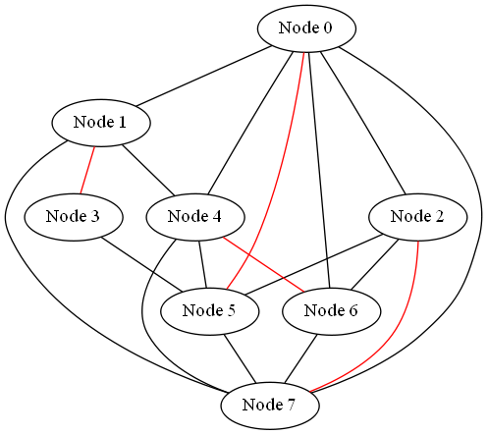

Slide 10
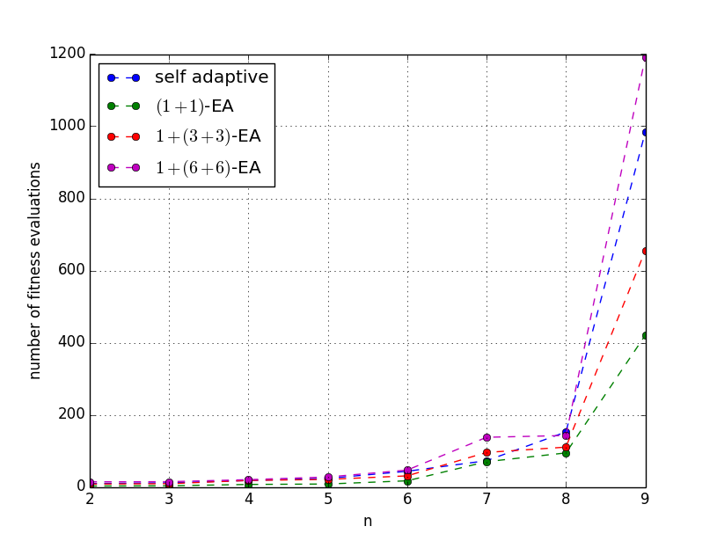
Ring graphs

Slide 11
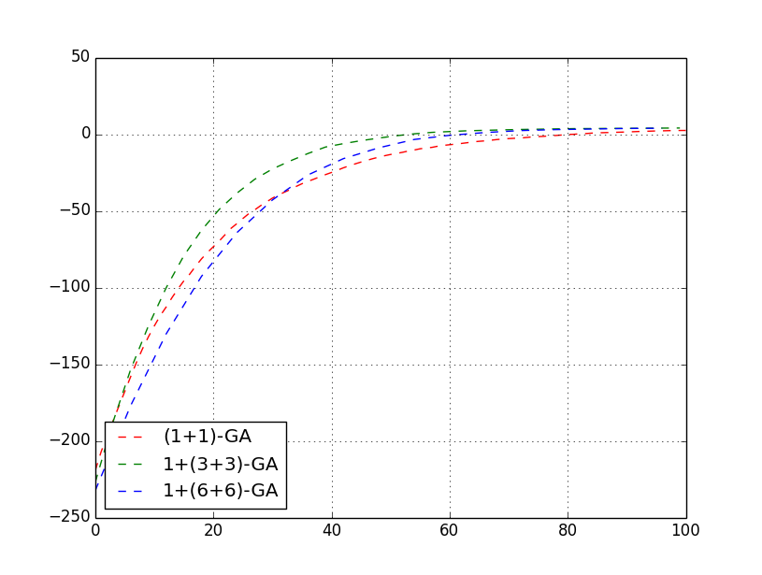
Random 3-friend graphs

Slide 12
Euler cycle
0
2↔ 4, 5↔7, 6↔3
…
1↔2, 3↔4
1
n-1↔ 0
n

Slide 13
Fitness function
Count k: number of indepedant walks
Count edges used
Fitness = - (number of edges – number of edges used) - k

Slide 14

Mutation
e’
e
V
f
f’

Slide 15
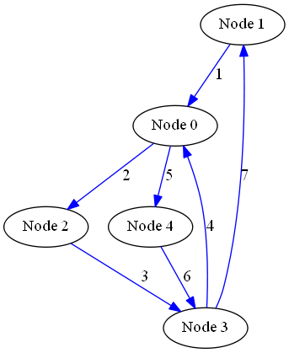
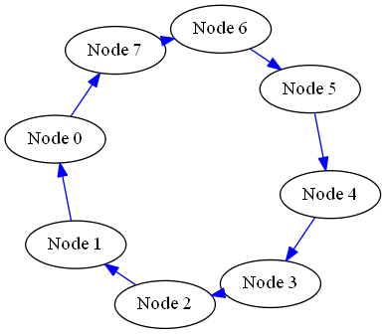
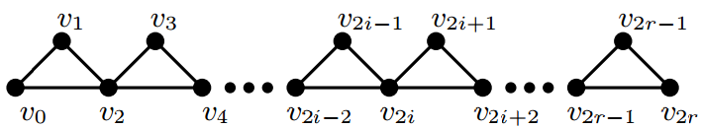
Euler cycle

Slide 16
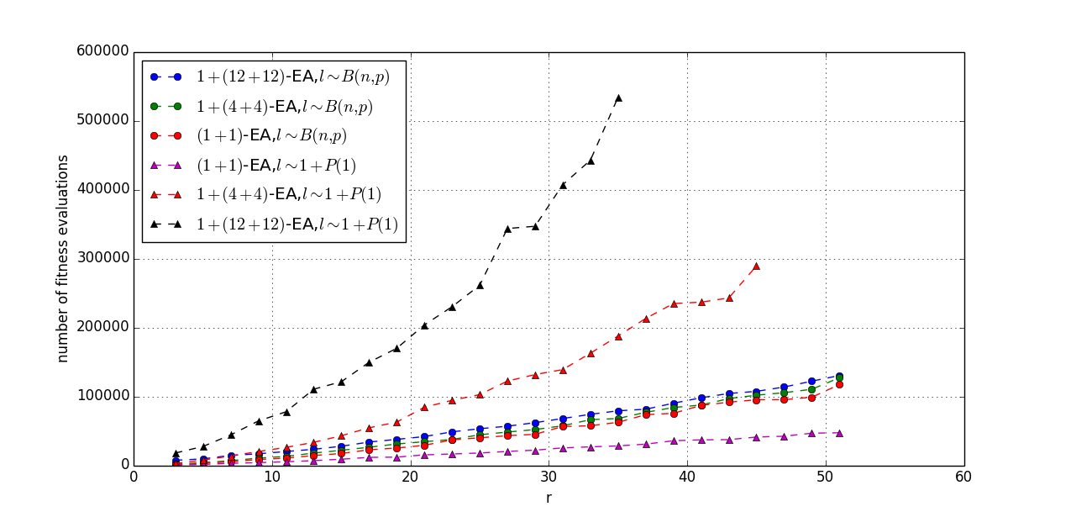
Binomial vs Poisson

Slide 17
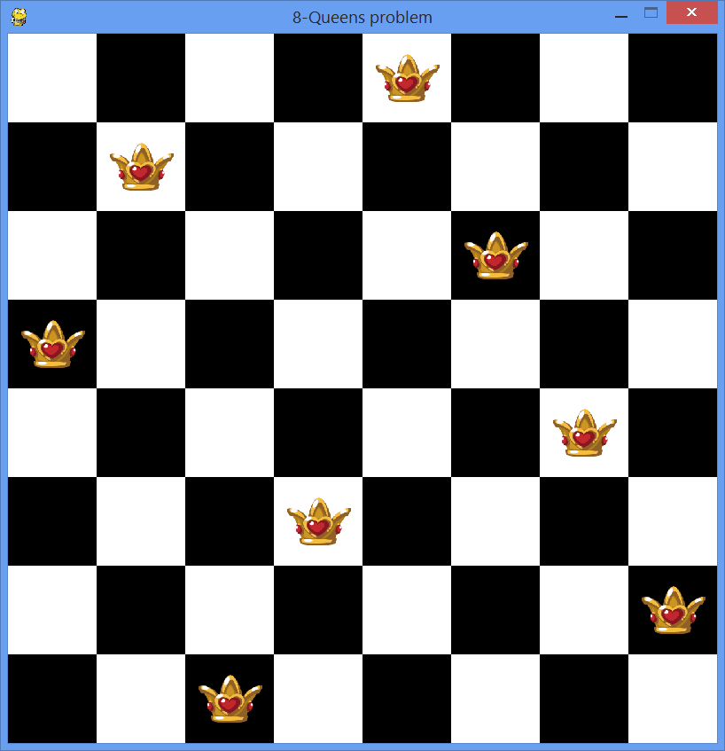
Chess
0
1
2
5
3
4
4
1
2
0
5
6
6
3
7
7

Slide 18

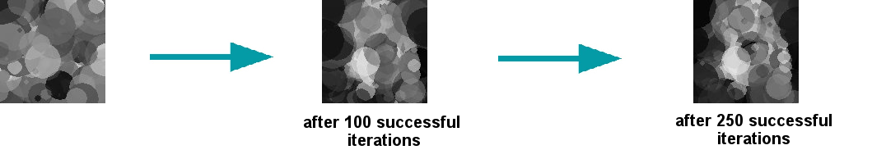
2D reconstruct
0
1
(x,y,z, color, transparency)
…
(x,y,z, color, transparency)
(x,y,z, color, transparency)
n
Notes:
Gray code representation

Slide 19
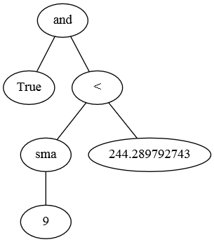
Finance

Slide 20
Simulations

